Slide 1
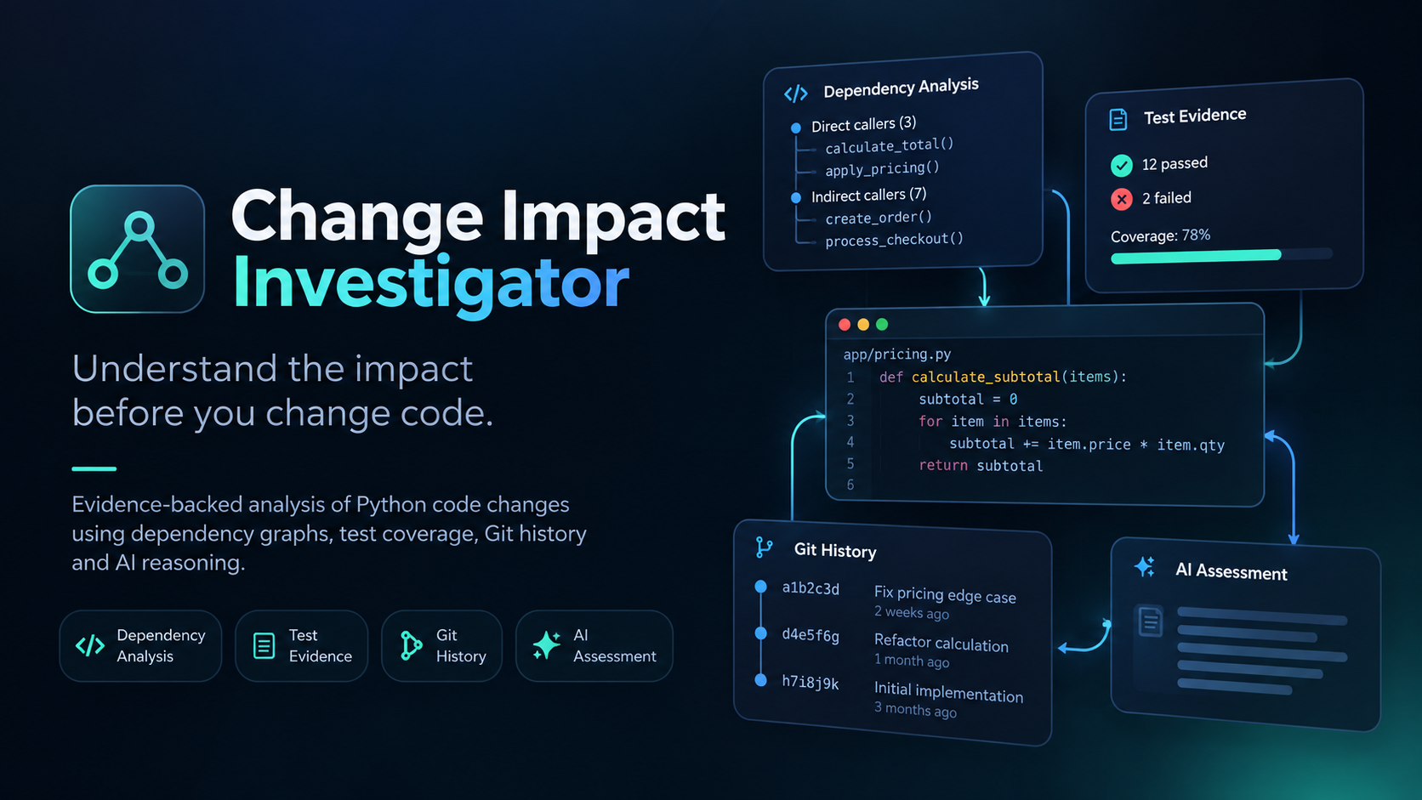
AI-ASSISTED DEVELOPER TOOL
Change Impact
Investigator
“Know the blast radius before you change code.”
A small change to one Python function can ripple through its callers, tests, and history — and most of that ripple is invisible until something breaks.
Function
→
Caller
→
Tests
→
Coverage
→
History
Our solution An evidence-first tool that investigates a proposed code change and turns deterministic repository evidence into an AI-assisted impact assessment.
Category: AI-powered code intelligence for software engineering

Slide 2












How It Works
From a developer's question to a structured, evidence-backed impact assessment.
→
→
→
→
→
→
Question
Repository
AST Analysis
Tests +
Coverage
Git History
Evidence
Aggregation
AI Reasoning
Python AST
Tests
Coverage
Git History
AI Reasoning
Extracts functions and their caller/callee relationships through deterministic static analysis — not AI guesses.
Identifies related tests and reports current pass, fail, and error status.
Shows whether code paths around the change are actually exercised by the test suite.
Adds historical context — prior commits, authors, and messages tied to the affected code.
Synthesizes the collected evidence into a concise, developer-facing impact assessment.

Slide 3

Evidence Before AI
The system collects proof first. The AI interprets — it doesn't invent.
Dependency Graph
Test Results
Direct and indirect callers reveal how far a change could propagate.
Existing tests show what functionality is currently validated.
Coverage
Git History
Uncovered paths flag areas that may need additional testing.
Prior changes provide historical context around the affected code.
Structured Evidence
→
AI Reasoning
→
Impact Assessment
The AI never discovers dependencies on its own — it reasons only over evidence already collected from the repository.

Slide 4

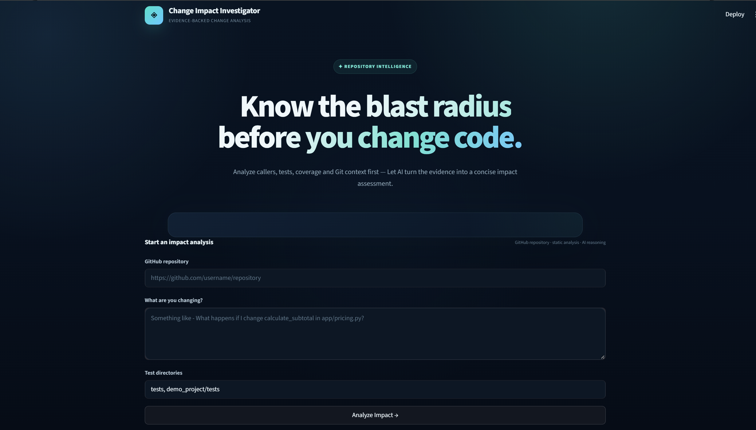



The Actual Application
A working Streamlit tool — not a mockup.
1. Enter the repository
Provide a GitHub repository URL
2. Describe the change
Ask in plain language — e.g. “what happens if I change calculate_subtotal?”
3. Add test directories
Tell it where the test suite lives so results can be checked against it.
4. Run the analysis
Dependency, test, coverage, and history evidence feed an AI-assisted impact assessment.
Streamlit frontend · evidence-backed change analysis

Slide 5
From Repository Evidence To
Developer Action
What the impact assessment gives back
Change
→
Evidence
→
Analysis
→
Investigation Report
The report surfaces:
WHY IT MATTERS
Affected functions and their direct/indirect callers
“Instead of manually searching across a repository, developers get the relevant evidence and context in one place.”
Related tests and their current status
Coverage gaps in the affected code paths
Relevant Git history and authorship
Specific areas worth investigating before merging
Future direction broader language support · pull-request integration · richer repository visualizations · CI/CD integration

